Slide 1
Generating HAPI extension for HL7 custom Z segments v 0.2
Darius Kemeklis
Technical Direction / System Architecture
Delivery Service / Common Services Team
Electronic Data Systems/Veteran Affairs Health Administration
(darius.kemeklis@med.va.gov)

Slide 2
Generic Z segment HAPI APIs
There are two ways to read custom Z segments using HAPI:
Generic HAPI-only API:
ADT_A01 adt = (ADT_A01)er7Parser.parse( ADT_A08 );
ADT_A01_PR1ROL procedure = adt.getADT_A01_PR1ROL();
GenericSegment seg = (GenericSegment)procedure.get("ZEL");
Type t = ((Varies)seg.getField(9,0)).getData();
Generic HAPI-based XML API:
ADT_A01 adt = (ADT_A01)er7Parser.parse( ADT_A08 );
DefaultXMLParser xmlParser = new DefaultXMLParser();
String xmlMessage = xmlParser.encode( adt );
executeXpath( xmlMessage,
"/ADT_A01/ADT_A01.PROCEDURE/ZEL/ZEL.9/text()" ); //Vet status

Slide 3
Generated specialized Z segment APIs
Took PSIM (thank Gary Duff) approach + Frank Sauer’s XSLT transform idea
XSLT auto-generates Java specialized Z segment APIs based on HAPI using:
  Input: MWB Conformance Profile for all VA Z segments
  Process: XSLT takes conformance profile as an input and creates a java class source file with specializes APIs based on HAPI for each Z segment in conformance profile
  Result: Specialized Z segment APIs based on HAPI for each custom Z segment in the conformance profile
Pros:
  Generates add-on java classes in seconds
  No need to custom-code each Z segment
  Uses HAPI infrastructure / No changes to existing HAPI libs – minimal work
  Can be incorporated into MWB
  Generates single Java API for all HeV efforts to use when working with Z segments

Slide 4
Generated specialized Z segment APIs (cont.)
The client code looks just like other HAPI client code:
ADT_A01 adt = (ADT_A01)er7Parser.parse( ADT_A08 );
ADT_A01_PR1ROL procedure = adt.getADT_A01_PR1ROL();
ZEL zel = (ZEL)procedure.get("ZEL");
ST typeOfPatient = zel.getTypeOfPatient();
The client code looks just like other HAPI client code.
Clients do not need to know the exact structure of the message
If message structure changes, but no the content – no change on client.

Slide 5
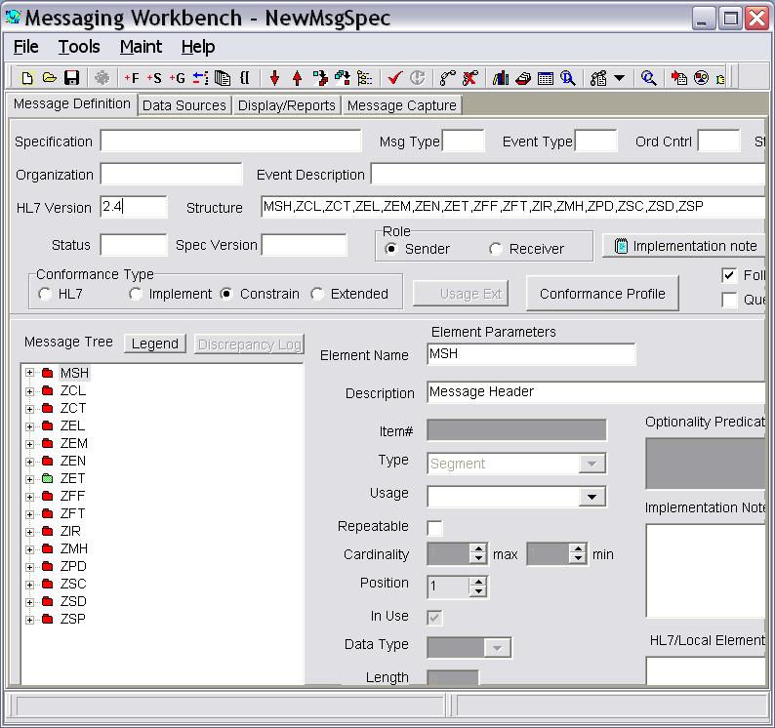
WMB how-to
Open MWB
Go to /Maint/Libraries/Show Conformance Files/Select “VistaSD&DZSegs.mcf”
Go to /Maint/Libraries/Rebuild Lib From Segs
Go to /Tools/Compile Message
Fill-in HL7 Version text box with “2.4”
(See result on the right)

Slide 6
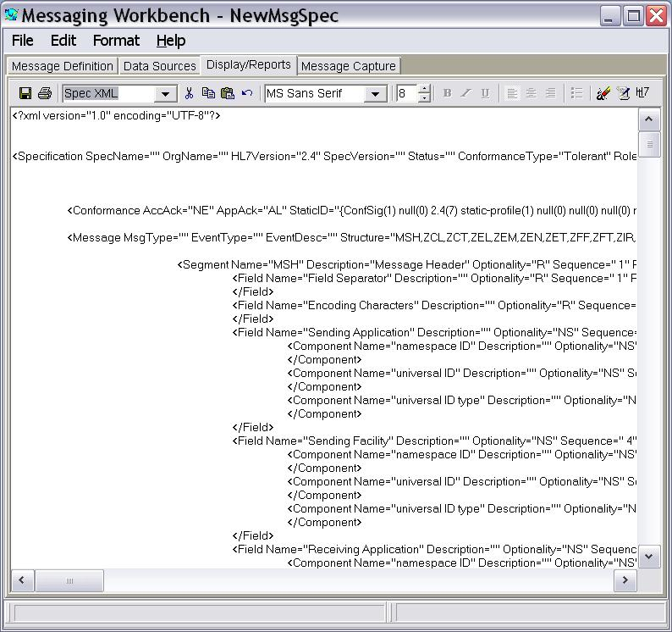
WMB how-to (cont. 1)
Go to Display/Reports tab
Select “Spec XML” from the drop-down

Slide 7
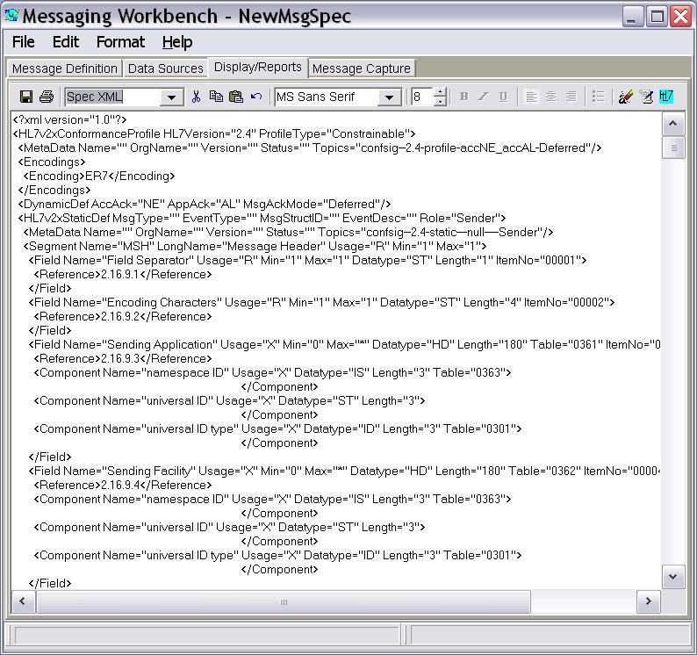
WMB how-to (cont. 2)
Click on the right side tool bar button “Generate HL7 registry profile”

Slide 8
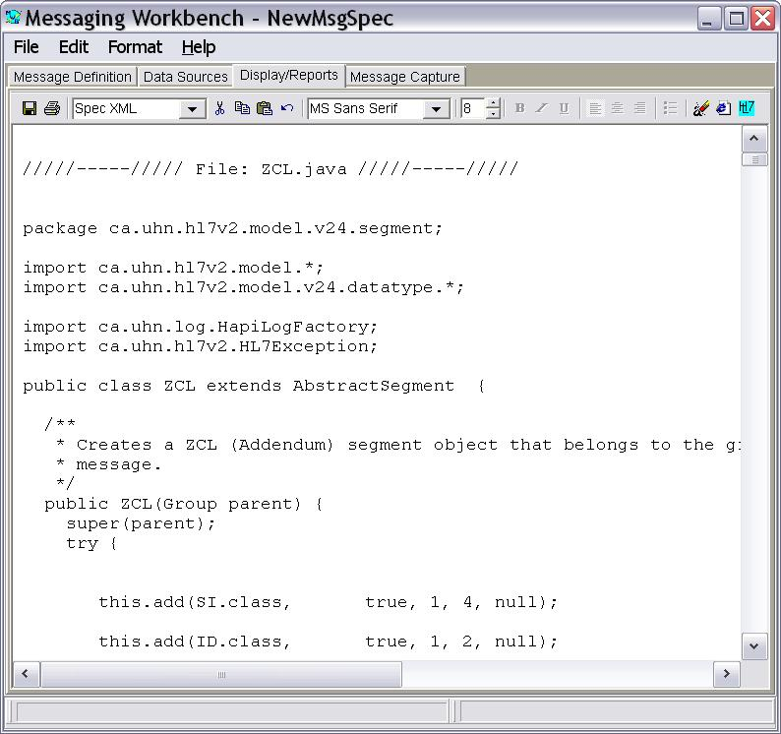
WMB how-to (cont. 3)
Go to /File/Apply XSL To Report
Select javaZ.1.0.xsl
Click on the toolbar “Browser” button (the one before the green hl7 button) to produce a report
Generates ONE java source file using XSLT.
  Reason: XSLT 1.0 does not have capability to output info into multiple files.
  MSXML used within MWB does not have custom extensions to output info into multiple files
ToDo:
  Split file into separate discrete java src files – Peter Rontey will help here.

Slide 9
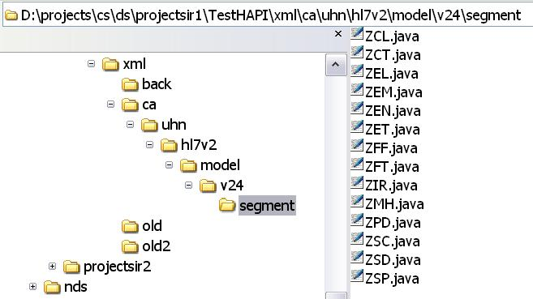
Standalone how-to
Download and unpack Saxon8 from http://saxon.sourceforge.net/
Input: safe MWB generated HL7 Conformance Profile as explained in previous slides into a separate xml file (example: VHAZSegmentCPs.xml).
Process: use following command line:
java –jar %SAXON8_HOME%/saxon8.jar VHAZSegmentCPs.xml javaZ.2.0.xsl
Output: generates Z segment java src files in Z segment java src {$basePath}/ca/uhn/hl7v2/model/v24/segment.*
  Where basePath is a variable in javaZ.2.0.xsl. Default “./”
Internally both javaZ.1.0.xsl and javaZ.2.0.xsl include/use javaZ.core.xsl.

Slide 10
Tools To Do’s
Tool’s To Do’s:
  Split XSLT 1.0 based output concatenated file into multiple java files within MWB
  Tighter integration with MWB – maybe a button or menu item
  More Testing
  Automated build/test scripts
  Decision on who/when/how is going to use this tool within HeV

Slide 11
Conclusion
Auto-generating specialized Z segment HAPI-based APIs will allow:
  Project teams to concentrate on the business part of message handling instead of on the message handling semantics itself.
  DS team will not need to custom-code and maintain specialized Z segment APIs.
….? Questions ? ….

